Slide 1
Inference in First-Order Logic (FOL)

Slide 2
Outline
Reducing first-order inference to propositional inference
Unification and Lifting
Generalized Modus Ponens
Forward chaining
Backward chaining
Resolution

Slide 3
Universal instantiation (UI)
Every instantiation of a universally quantified sentence is entailed by it:
∀v α
Subst({v/g}, α)
for any variable v and ground term g
E.g., ∀x King(x) ∧ Greedy(x) ⇒ Evil(x) yields:
  King(John) ∧ Greedy(John) ⇒ Evil(John)
  King(Richard) ∧ Greedy(Richard) ⇒ Evil(Richard)
  King(Father(John)) ∧ Greedy(Father(John)) ⇒ Evil(Father(John))

Slide 4
Existential instantiation (EI)
For any sentence α, variable v, and constant symbol k that does not appear elsewhere in the knowledge base:
∃v α
Subst({v/k}, α)
E.g., ∃x Crown(x) ∧ OnHead(x,John) yields:
Crown(C₁) ∧ OnHead(C₁,John)
provided C₁ is a new constant symbol, called a Skolem constant

Slide 5
Reduction to propositional inference
Suppose the KB contains just the following:
  ∀x King(x) ∧ Greedy(x) ⇒ Evil(x)
  King(John)
  Greedy(John)
  Brother(Richard,John)
Instantiating the universal sentence in all possible ways, we have:
  King(John) ∧ Greedy(John) ⇒ Evil(John)
  King(Richard) ∧ Greedy(Richard) ⇒ Evil(Richard)
  King(John)
  Greedy(John)
  Brother(Richard,John)
The new KB is propositionalized: proposition symbols are
  King(John), Greedy(John), Evil(John), King(Richard), etc.

Slide 6
Problems with propositionalization
Propositionalization seems to generate lots of irrelevant sentences.
E.g., from:
  ∀x King(x) ∧ Greedy(x) ⇒ Evil(x)
  King(John)
  ∀y Greedy(y)
  Brother(Richard,John)
it seems obvious that Evil(John), but propositionalization produces lots of facts such as Greedy(Richard) that are irrelevant

Slide 7
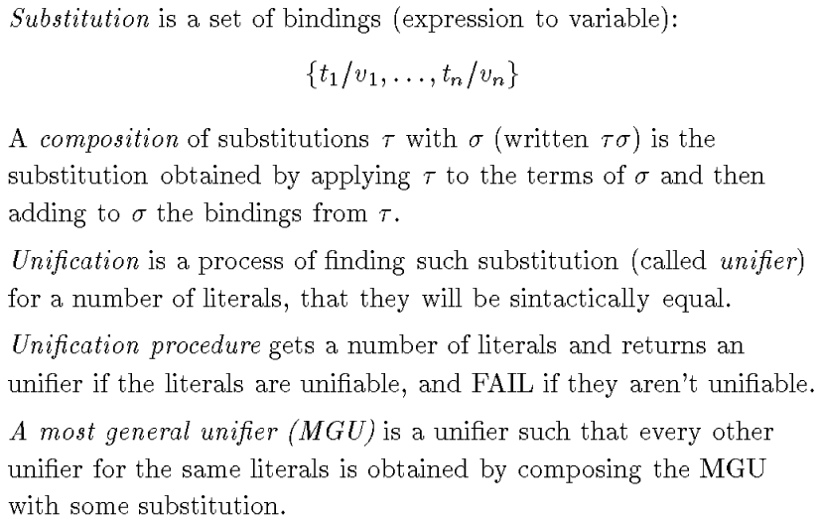
Unification
Finding substitutions that make different logical expressions look identical is known as unification.

Slide 8
Unification
We can get the inference immediately if we can find a substitution θ such that King(x) and Greedy(x) match King(John) and Greedy(y)
θ = {x/John,y/John} works
Unify(α,β) = θ if αθ = βθ
p q θ
Knows(John,x) Knows(John,Jane)
Knows(John,x) Knows(y,OJ)
Knows(John,x) Knows(y,Mother(y))
Knows(John,x) Knows(x,OJ)
Standardizing apart eliminates overlap of variables, e.g., Knows(z₁₇,OJ)

Slide 9
Unification
We can get the inference immediately if we can find a substitution θ such that King(x) and Greedy(x) match King(John) and Greedy(y)
θ = {x/John,y/John} works
Unify(α,β) = θ if αθ = βθ
p q θ
Knows(John,x) Knows(John,Jane) {x/Jane}}
Knows(John,x) Knows(y,OJ)
Knows(John,x) Knows(y,Mother(y))
Knows(John,x) Knows(x,OJ)
Standardizing apart eliminates overlap of variables, e.g., Knows(z₁₇,OJ)

Slide 10
Unification
We can get the inference immediately if we can find a substitution θ such that King(x) and Greedy(x) match King(John) and Greedy(y)
θ = {x/John,y/John} works
Unify(α,β) = θ if αθ = βθ
p q θ
Knows(John,x) Knows(John,Jane) {x/Jane}}
Knows(John,x) Knows(y,OJ) {x/OJ,y/John}}
Knows(John,x) Knows(y,Mother(y))
Knows(John,x) Knows(x,OJ)
Standardizing apart eliminates overlap of variables, e.g., Knows(z₁₇,OJ)

Slide 11
Unification
We can get the inference immediately if we can find a substitution θ such that King(x) and Greedy(x) match King(John) and Greedy(y)
θ = {x/John,y/John} works
Unify(α,β) = θ if αθ = βθ
Knows(John,x) Knows(John,Jane) {x/Jane}}
Knows(John,x) Knows(y,OJ) {x/OJ,y/John}}
Knows(John,x) Knows(y,Mother(y)) {y/John,x/Mother(John)}}
Knows(John,x) Knows(x,OJ)
Standardizing apart eliminates overlap of variables, e.g., Knows(z₁₇,OJ)
p q θ

Slide 12
Unification
We can get the inference immediately if we can find a substitution θ such that King(x) and Greedy(x) match King(John) and Greedy(y)
θ = {x/John,y/John} works
Unify(α,β) = θ if αθ = βθ
p q θ
Knows(John,x) Knows(John,Jane) {x/Jane}}
Knows(John,x) Knows(y,OJ) {x/OJ,y/John}}
Knows(John,x) Knows(y,Mother(y)) {y/John,x/Mother(John)}}
Knows(John,x) Knows(x,OJ) {fail}
Standardizing apart eliminates overlap of variables, e.g., Knows(z₁₇,OJ)

Slide 13
Unification
To unify Knows(John,x) and Knows(y,z),
θ = {y/John, x/z } or θ = {y/John, x/John, z/John}
The first unifier is more general than the second.
There is a single most general unifier (MGU) that is unique up to renaming of variables.
  MGU = { y/John, x/z }

Slide 14
Generalized Modus Ponens (GMP)
p₁', p₂', … , p_{n}', ( p₁ ∧ p₂ ∧ … ∧ p_{n} ⇒q)
qθ
p₁' is King(John) p₁ is King(x)
p₂' is Greedy(y) p₂ is Greedy(x)
θ is {x/John,y/John} q is Evil(x)
q θ is Evil(John)
Generalized Modus Ponens is a lifted version of Modus Ponens—it raises Modus Ponens from ground (variable-free) propositional logic to first-order logic.
GMP used with KB of definite clauses (exactly one positive literal)
All variables assumed universally quantified
where p_{i}'θ = p_{i} θ for all i

Slide 15
Example knowledge base
The law says that it is a crime for an American to sell weapons to hostile nations. The country Nono, an enemy of America, has some missiles, and all of its missiles were sold to it by Colonel West, who is American.
        Prove that Col. West is a criminal

Slide 16
Example knowledge base contd.
... it is a crime for an American to sell weapons to hostile nations:
  American(x) ∧ Weapon(y) ∧ Sells(x,y,z) ∧ Hostile(z) ⇒ Criminal(x)
Nono … has some missiles, i.e., ∃x Owns(Nono,x) ∧ Missile(x):
… all of its missiles were sold to it by Colonel West
  Missile(x) ∧ Owns(Nono,x) ⇒ Sells(West,x,Nono)
Missiles are weapons:
An enemy of America counts as "hostile“:
  Enemy(x,America) ⇒ Hostile(x)
West, who is American …
The country Nono, an enemy of America …
Enemy(Nono,America)
American(West)
Missile(x)  Weapon(x)
Owns(Nono,M1) and Missile(M1)

Slide 17
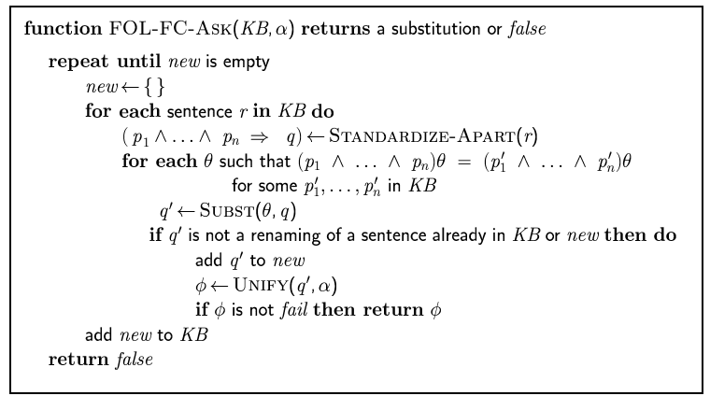
Forward chaining algorithm

Slide 18
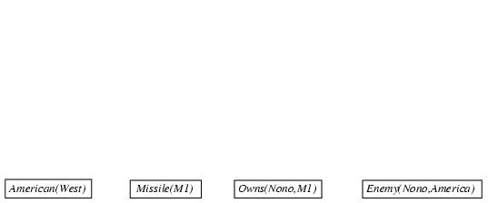
Forward chaining proof

Slide 19
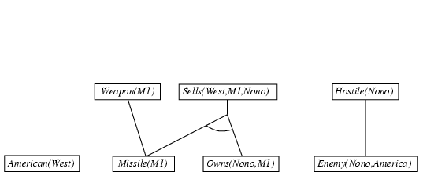
Forward chaining proof

Slide 20
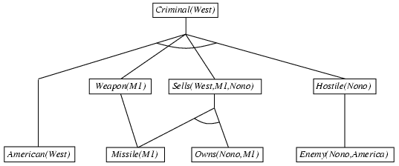
Forward chaining proof

Slide 21
Properties of forward chaining
Sound and complete for first-order definite clauses
Datalog = first-order definite clauses + no functions
FC terminates for Datalog in finite number of iterations
May not terminate in general if α is not entailed
This is unavoidable: entailment with definite clauses is semidecidable

Slide 22
Efficiency of forward chaining
Incremental forward chaining: no need to match a rule on iteration k if a premise wasn't added on iteration k-1
  ⇒ match each rule whose premise contains a newly added positive literal
Matching itself can be expensive:
Database indexing allows O(1) retrieval of known facts
  e.g., query Missile(x) retrieves Missile(M₁)
Forward chaining is widely used in deductive databases

Slide 23
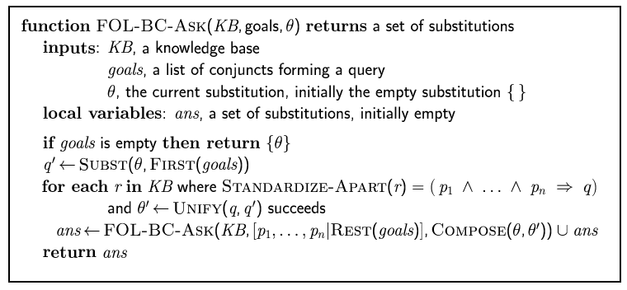
Backward chaining algorithm
SUBST(COMPOSE(θ₁, θ₂), p) = SUBST(θ₂, SUBST(θ₁, p))

Slide 24

Backward chaining example

Slide 25
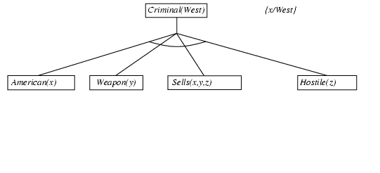
Backward chaining example

Slide 26
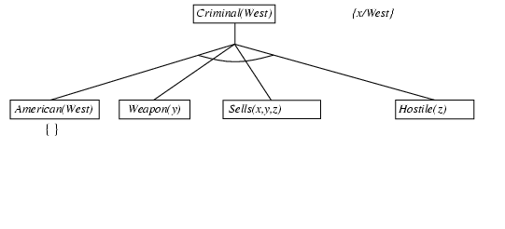
Backward chaining example

Slide 27
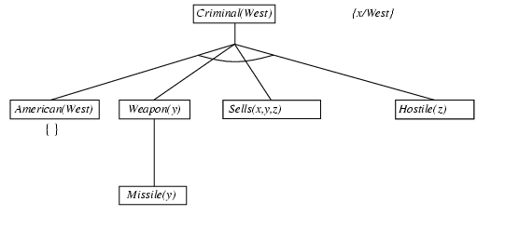
Backward chaining example

Slide 28
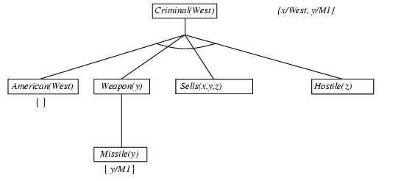
Backward chaining example

Slide 29
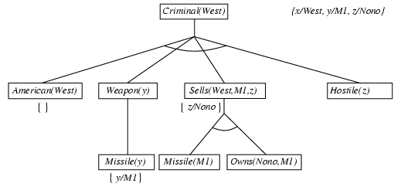
Backward chaining example

Slide 30
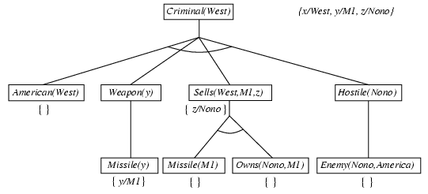
Backward chaining example

Slide 31
Backward chaining example

Slide 32
Properties of backward chaining
Depth-first recursive proof search: space is linear in size of proof
Incomplete due to infinite loops
  ⇒ fix by checking current goal against every goal on stack
Inefficient due to repeated subgoals (both success and failure)
  ⇒ fix using caching of previous results (extra space)
Widely used for logic programming

Slide 33
Resolution: brief summary
Full first-order version: Generic Representation of Unification
l₁ ∨ ··· ∨ l_{k}, m₁ ∨ ··· ∨ m_{n}
(l₁ ∨ ··· ∨ l_{i-1} ∨ l_{i+1} ∨ ··· ∨ l_{k} ∨ m₁ ∨ ··· ∨ m_{j-1} ∨ m_{j+1} ∨ ··· ∨ m_{n})θ
where Unify(l_{i}, ¬m_{j}) = θ.
The two clauses are assumed to be standardized apart so that they share no variables.
For example,
¬Rich(x) ∨ Unhappy(x)
Rich(Ken)
Unhappy(Ken)
Apply resolution steps to CNF(KB ∧ ¬α); complete for FOL
with θ = {x/Ken}

Slide 34
Example Problem 1
KB:
Everyone who loves all animals is loved by someone.
Anyone who kills animals is loved by no-one.
Jack loves all animals.
Either Curiosity or Jack killed the cat, who is named Tuna.
Query: Did Curiosity kill the cat?
Inference Procedure:
Express sentences in FOL.
Eliminate existential quantifiers.
Convert to CNF form and negated query.

Slide 35
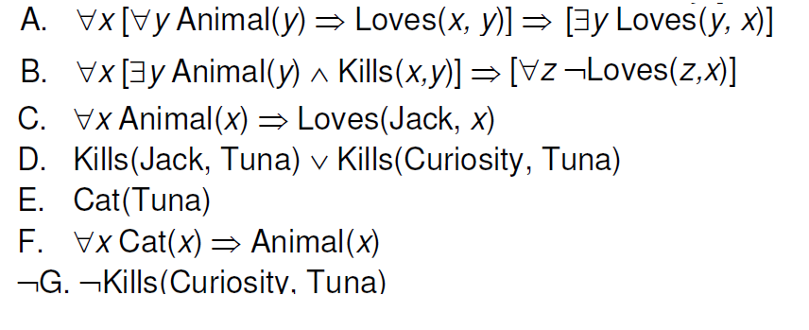
Conversion to FOL

Slide 36
Conversion to CNF
Everyone who loves all animals is loved by someone:
  ∀x [∀y Animal(y) ⇒ Loves(x,y)] ⇒ [∃y Loves(y,x)]
1. Eliminate biconditionals and implications
  ∀x [¬∀y ¬Animal(y) ∨ Loves(x,y)] ∨ [∃y Loves(y,x)]
2. Move ¬ inwards: ¬∀x p ≡ ∃x ¬p, ¬ ∃x p ≡ ∀x ¬p
  ∀x [∃y ¬(¬Animal(y) ∨ Loves(x,y))] ∨ [∃y Loves(y,x)]
  ∀x [∃y ¬¬Animal(y) ∧ ¬Loves(x,y)] ∨ [∃y Loves(y,x)]
  ∀x [∃y Animal(y) ∧ ¬Loves(x,y)] ∨ [∃y Loves(y,x)]

Slide 37
Conversion to CNF contd.
Standardize variables: each quantifier should use a different one
  ∀x [∃y Animal(y) ∧ ¬Loves(x,y)] ∨ [∃z Loves(z,x)]
Skolemize: a more general form of existential instantiation.
  Each existential variable is replaced by a Skolem function of the enclosing universally quantified variables:
  ∀x [Animal(F(x)) ∧ ¬Loves(x,F(x))] ∨ Loves(G(x),x)
Drop universal quantifiers:
7. Distribute ∨ over ∧ : [Conjunctive of Disjunctive = POS]
[Animal(F(x))  Loves(G(x),x)]  [➢Loves(x,F(x))  Loves(G(x),x)]
[Animal(F(x))  ➢Loves(x,F(x))]  Loves(G(x),x) [ SOP = Sum of Product]

Slide 38
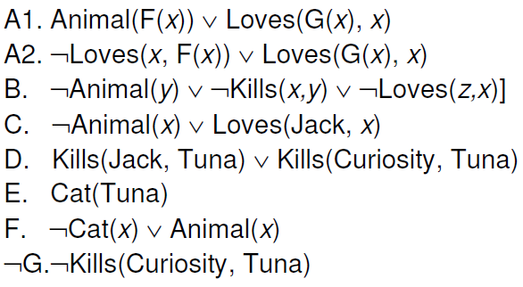
Final CNF
Notes:
To get A1, A2. a) skolemize first existential quantifier in consequen using G(x). Then negate implication, gives me existential in antecedent. Skolemize using f(x). Now I have conjunction from antecedent or consequent, distribute conjunction.

Slide 39
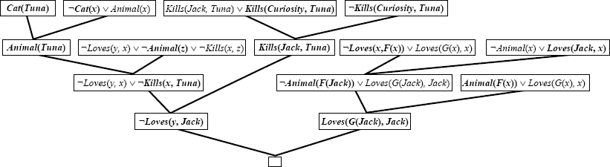
Resolution-based Inference
Notes:
Left half: just regular without skolem, basically says that if Jack did kill Tuna, then nobody loves jack.
Right side: use unification x:=jack on left, x := F(jack) on right.

Slide 40
Example knowledge base
The law says that it is a crime for an American to sell weapons to hostile nations. The country Nono, an enemy of America, has some missiles, and all of its missiles were sold to it by Colonel West, who is American.
        Prove that Col. West is a criminal

Slide 41
Example knowledge base contd.
... it is a crime for an American to sell weapons to hostile nations:
  American(x) ∧ Weapon(y) ∧ Sells(x,y,z) ∧ Hostile(z) ⇒ Criminal(x)
Nono … has some missiles, i.e., ∃x Owns(Nono,x) ∧ Missile(x):
  Owns(Nono,M₁) and Missile(M₁)
… all of its missiles were sold to it by Colonel West
  Missile(x) ∧ Owns(Nono,x) ⇒ Sells(West,x,Nono)
Missiles are weapons:
  Missile(x) ⇒ Weapon(x)
An enemy of America counts as "hostile“:
  Enemy(x,America) ⇒ Hostile(x)
West, who is American …
  American(West)
The country Nono, an enemy of America …
  Enemy(Nono,America)

Slide 42
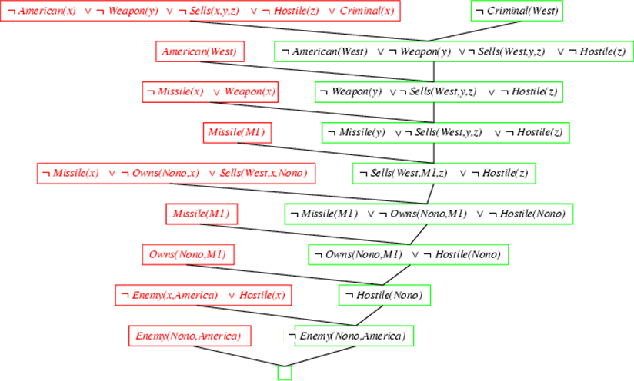
Resolution proof: definite clauses

